Slide 1
Unity 3D and Azure
Simplified approach to storing game data in the cloud

Slide 2
Our Background
Who We Are
Andrew Boudreau – Web Developer @andrewboudreau
Dylan Ryan - Unity Developer
What We Do
https://github.com/mLevel/
C# .NET developers in casual learning space, mLevel.com
Targeting Enterprise Customers (woe is me)
Need to support a variety of black-box authentication mechanisms
We can’t use Game Center or Google’s Play

Slide 3
Tools & Technologies
A completely free solution
A functional example disguised as a leaderboard
Targeting C# development
Client solution
Unity 3D
Serialization LitJSON
Custom Services Library
Server solution
Azure Websites
Web Services using ASP.NET WebApi 2.0
Data Persistence using Entity Framework 6 & Azure SQL free edition (20mb)
Security using Microsoft Identity for Authorization
Automatically deployed using GitHub

Slide 4
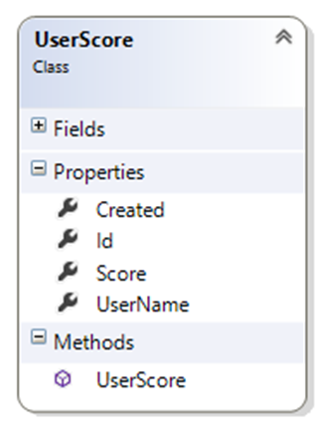
Data Payload

Slide 5


Who said what?
Requests Authentication (User/Pass)
Returns Token
Play Game
Submit UserScore w/ Token Header
Returns All UserScores

Slide 6
Unity3D Implementation
Game Loop vs Event based coding
Component based architecture
Coroutines
The WWW class
Solution in action
Expanding on the solution.

Slide 7
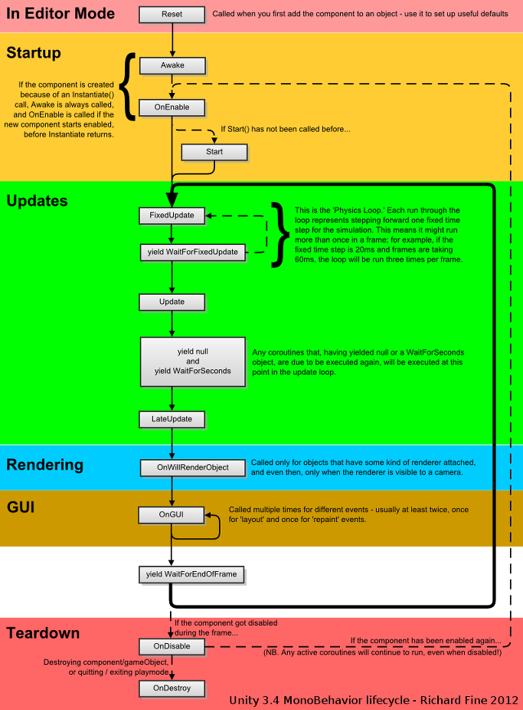
Component based architecture
weblink

Slide 8
demo

Slide 9
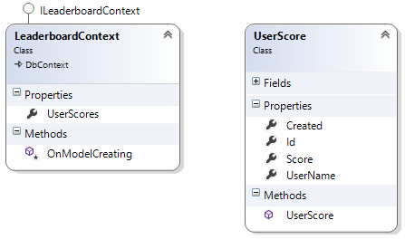
Data Transfer Diagram

Slide 10
demo

Slide 11
Thanks
github.com/mlevel

Slide 12
Creating The Leaderboard.Data Project
Create the entity model
Create the datacontext
create the conventions
create the test project
create the AssemblyInitializeTest
Create the DropCreateDatabaseAlways
Create the userscoretest
Create the web api project
Auto api docs
Defaults for Route, Filter, Startup.Auth
WebApiConfig
XHttpMethodOverride
Supresshostauth
Attribute routes
Enable CORS
Leaderboard controller
Get scores
Write scores
To Auth or Not To Auth
Auth Controller
Black box
Deploy To GitHub
Setup Azure
Create website
Free database
Auto deploy from github
Kurl.IT

Slide 13
Coroutines
What the heck are they
long running non processor intensive operations
Why not threads? (poor mans threading?)
What does it do?
Ok, so how do I do it?
Using coroutines for non blocking service calls.
Limitations/Workarounds
WWW

Slide 14
Expanding on the simple solution
Here is some of the things we did in our implementation to create a more robust architecture.
Wrapper class to make Service calls, ServiceTask
Canceling Service calls
HTTP error code parsing
JSON Library abstraction (per platform)

